Slide 1

BANKING - ANALYSIS OF BANK MARKETING
TEAM B
VAISHALI S
SATHYA NARAYANAN S
MANJU R
MONISHA K
POOJA BEDI V

Slide 2
OBJECTIVES
Term deposits are a major source of income for a bank. A term deposit is a cash investment held at a financial institution. Your money is invested for an agreed rate of interest over a fixed amount of time, or term.
Our Project is to analyze a dataset of 12000+ Clients Records given the term deposit subscribed or not.
Our Project can pursue goals based on loan status, education qualification, age, contact and Identifying the most effective way of marketing.

Slide 3

TECHNICAL SPECIFICATION
Data sources: CSV files(bank-full.csv)
Data storage : Local,MySQL
File formats: CSV
Data ingestion: Spark
Data cleansing and scrubbing : Spark
Data computation and Analysis: MySql, ML
ETL: Spark, Pandas, MySQL
Visualization : Grafana
Language : Python

Slide 4
ARCHITECTURE
Data Source – CSV
Data Ingestion – Spark
Data Processing - PySpark
Data Storage – Local,SQL
Visualization – Grafana

Slide 5
Ingestion and preparation of workflow 1 & 2
Load the CSV file to local machine using wget command
Started with PySpark and read the CSV file using PySpark.
Data frame created in Pyspark
Cleansing, Scrubbing and removing unrequired records from the table.
Dropping columns with null values.
Applying possible Transformation on data frames.
Implementing Pyspark dataframe to Mysql.
Integration from Mysql to Grafana.
Performing necessary transformation in a particular column.

Slide 6



WORKFLOW 1
T
R
A
N
S
F
O
R
M
A
T
I
O
N
LOAD
LOCAL
READ

Slide 7
TRANSFORMATIONS AND DATAFRAMES
Spark Transformation is a function that produces new Dataframe from the existing dataframes.
We used "filter" function to sort the column's age , loan and education under some conditions.
We applied ‘filter’ method to different age groups of the client.
Using "groupBy" function, analysed the total number of subscribers and non- subscribers to term deposit.
Using "groupBy" function to the 'contact' column ,we found the effective way of contacting the clients.

Slide 8





WORKFLOW 2

Slide 9
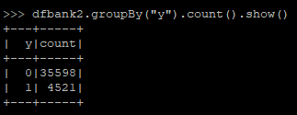
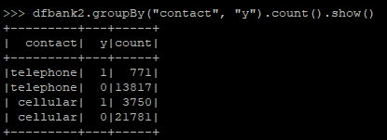
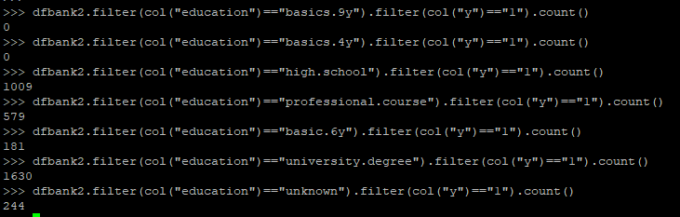

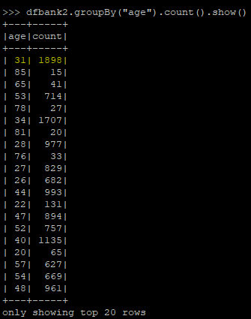

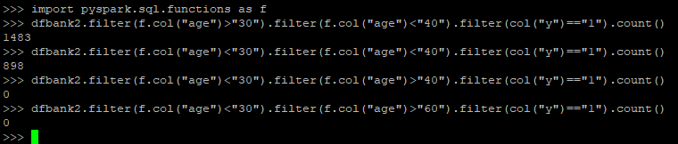
Business perspectives
Based on the Term Deposit column we have categorized the 'age','loan','education','contact' column to analysed the which is effective way of approch.

Slide 10
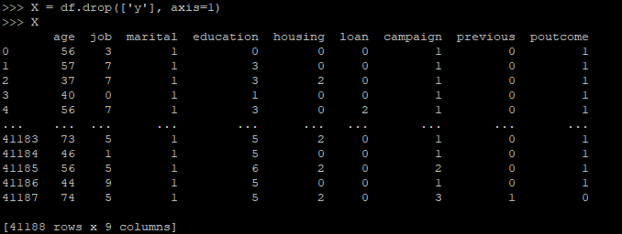
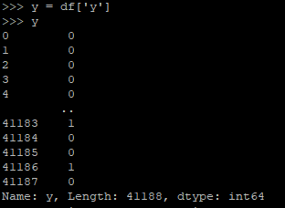

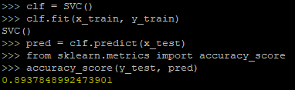
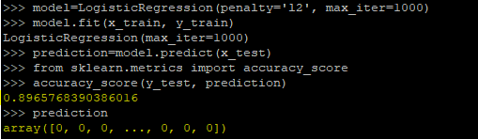
MaCHINE LEARNING
Random Forest gives more accuracy – 91%

Slide 11
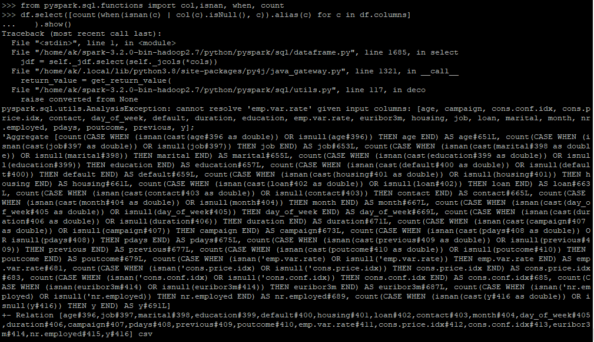
ERROR

Slide 12
1. WHICH MARKETING APPROACH IS EFFECTIVE?
Comparing cellular and telephone marketing approach , more number of clients subscribed the term deposit when contacted through cellular i.e out of 25,531 clients who are contacted through cellular 3,750 clients have subscribed the term deposit whereas in other out of 14,558 clients contacted through clients only 771 clients have subscribed.
2. WHICH AGE GROUP HAS HIGHER NUMBER OF SUBSCRIPTIONS?
Analyzing the entire data of the clients , we have came to know that there are more clients in the age group of 31 , i.e there are 1898 count and analyzed that under this age there are less number of count who have subscribed compared to not subscribed count.
3. WHAT IS RATIO OF CLIENT’S WHO HAVE SUBSCRIBED THE TERM DEPOSIT WHO HAVE LENDED A LOAN PREVIOUS AND CLIENTS WHO HAVE NOT LENDED ANY LOAN?
In accordance with the analysis , clients who have not taken any loan previously are higher in subscription of the Term Deposit.
4. WHEN CONSIDERING THE CLIENT'S EDUCATION STATUS ,WHICH CATEGORY HAS HIGHER NO SUBSCRIPTION?
Considering education as a parameter and analysing the dataset,the clients with a degree from university have a higher rate of subscriptions compared to the other education categories.
5. WHICH AGE GROUP HAS HIGHER NUMBER OF SUBSCRIPTIONS AND WHICH HAS THE LOWEST?? Analysing the clients details,the clients between the age 30 - 40 have subscribed the term deposit more, and clients at the age of 60 and above are null i.e no subscription have been made in this age group.

Slide 13
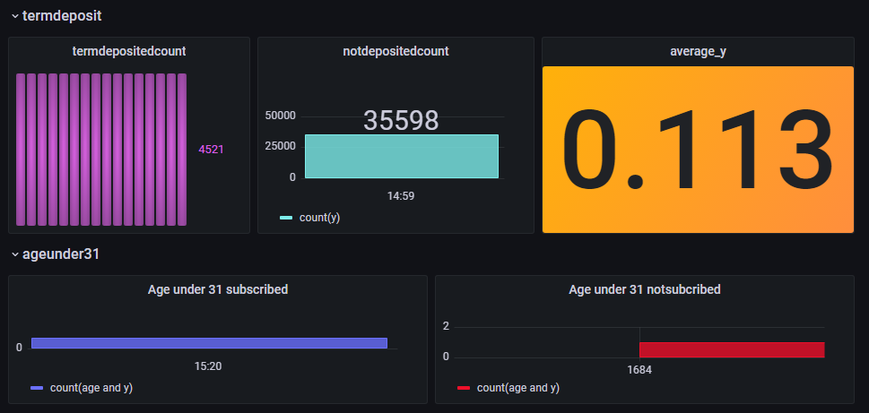
Data visualization

Slide 14
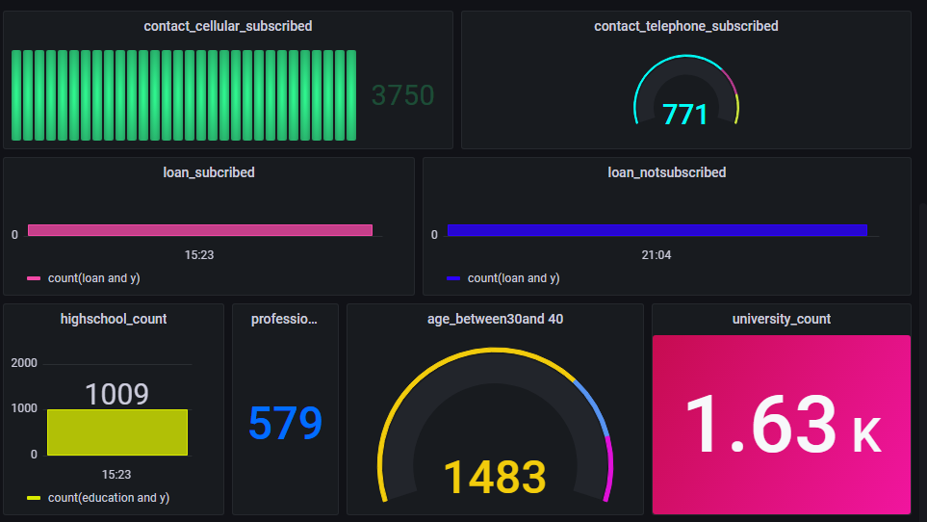

Slide 15
THANK YOU

